Slide 1
Live Bus Tracking and Intelligence in Estimation of Stop Arrival Times
By:
sanathan narayanan – 17bce1094
S Srihari – 17BCE1308

Slide 2
Abstract:
This project aims to track the location of our college buses in real time.
Day scholars face a problem not knowing the live location of the buses and esp. how long it takes for the bus to reach their stop.
Features like ‘estimated time of arrival’ will be implemented by reading speed, etc. data from college bus
All the routes, stops of buses will be shown in map

Slide 3
Motivation:
Students will be able to locate other buses if they miss their current bus.
They can get the bus’s ETA to reach their stop
Driver’s driving route can be monitored
Lost vehicles can be tracked
Monitor speed, get to know about traffic in routes, etc
These are achieved using accurate GPS module, all powered by bus itself

Slide 4
Domain knowledge:
Mobile Programming
Internet of Things
Cloud Computing
ML Algorithms
Python Coding for Raspberry Pi
Knowledge about GPS Module, Raspberry Pi

Slide 5
Existing System
Our college buses currently don’t have any live location tracking especially with an app for Students & Professors.
Also the systems as per reviewing many other papers, we have found they don’t have an intelligent estimation of the next stop arrival times which includes ML and a good Aesthetic Design made easy by an app which would be power efficient in terms of GPS usage, etc.

Slide 6
Proposed System
Here we propose a Hardware & Software Project where, Raspberry Pi & GPS Module would be fixed in College Buses.
The geolocation data would be sent to Firebase Cloud with help of internet using Python Code.
This data is then taken to the App developed using React Native.
The app would construct the routes, and would give ETAs, alarm features, etc.
The app tracks buses’ location in real time.

Slide 7
ARCHITECTURE DIAGRAM:
Android App
Neo 6m V2
Firebase
Geolocation Data
Raspberry Pi
Usage
(Track, ETAs, Alarms, etc)
Python Code
Power by Power Bank + Bus

Slide 8
Why we chose raspberry pi?
As, Raspberry Pi supports Raspbian OS, it can run MULTIPLE PROGRAMS AT ONCE
Whereas, Arduino or Nodemcu can run only one program at a time – This would help us to connect to different databases at the same time, extend this project with more features and more college buses to come in the future!!!
Raspberry Pi also can be easily connected to WIFI via built in facility & also can be connected to USB Dongles for internet in college buses (with out any external hardware required)
Nodemcu also doesn’t support USB Dongles for internet connections
Easier to run python codes in Raspberry, has built in support like NodeRED (for flow based programming)

Slide 9
Components & Software Used:
React Native for Android App --- React Native, so that can be extended to IOS too
Firebase for Cloud --- easy, free cloud service by Google
Raspberry Pi B3+ --- for scalability (adding more features in the future)
GY-NEO6MV2 NEO-6M GPS module --- Ceramic Antenna, EEPROM, etc
Power Bank + Power from College Bus --- for continuous power supply
Python Code for Raspberry Pi

Slide 10
7 Layers used in this project:
Layer 1: The Things Layer:
This layer of IoT comprises of devices, sensors and controllers – GPS Module, Raspberry Pi, Smartphones
2. Layer 2: Connectivity Layer:
This layer defines the various communication protocols and networks used for connectivity
We use Wi-Fi to connect Raspberry Pi to connect to Firebase cloud via internet
3. Layer 3: Global Infrastructure Layer:
This layer is typically implemented in cloud infrastructure.
We use Google’s Firebase for Cloud Storage purposes as firebase is easy & free to use (at least to a specific number of reads/writes)
4. Layer 4: Data Ingestion Layer:
This includes bigdata, cleansing, streaming and storage of data.
We manage the data in a real time database in Firebase Cloud

Slide 11
7 Layers used in this project cont:
Layer 5: Data Analysis Layer:
This layer relates to data reporting, mining, machine learning etc.
We use Machine Learning concept to predict the ETA of the bus stops, using few custom simulations.
Layer 6: The Application Layer:
This layer comprises of the custom applications that is actually making use of the things data.
Here, we have created a Cross Platform app using React Native which can work on both Android & IOS.
This app provides user friendly interface with simple & aesthetic design.
7. Layer 7: People and Process Layer:
This includes people, businesses, collaboration and decision making based on the information derived from IoT computing.
The users of this project would be Students & Professors using the College Bus facility

Slide 12
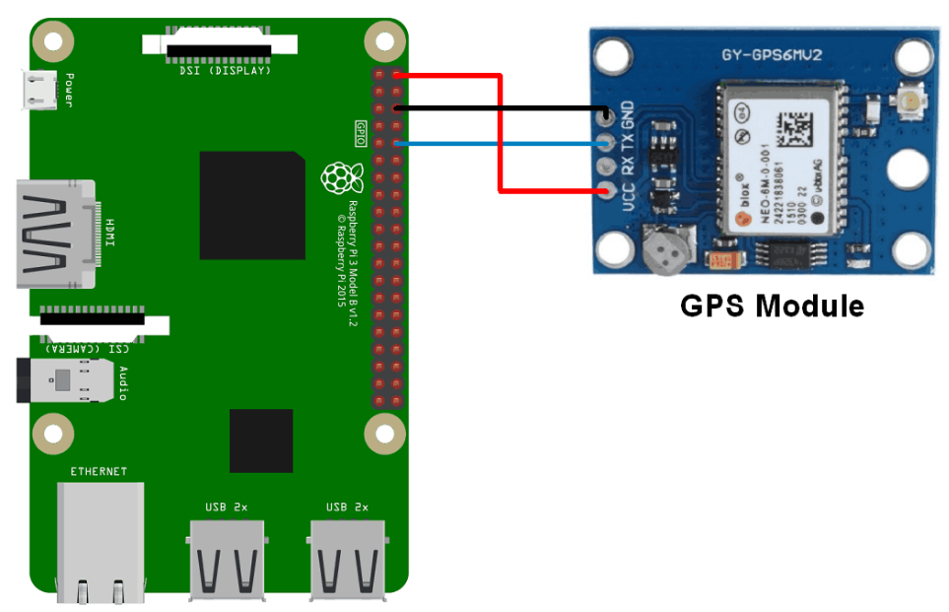
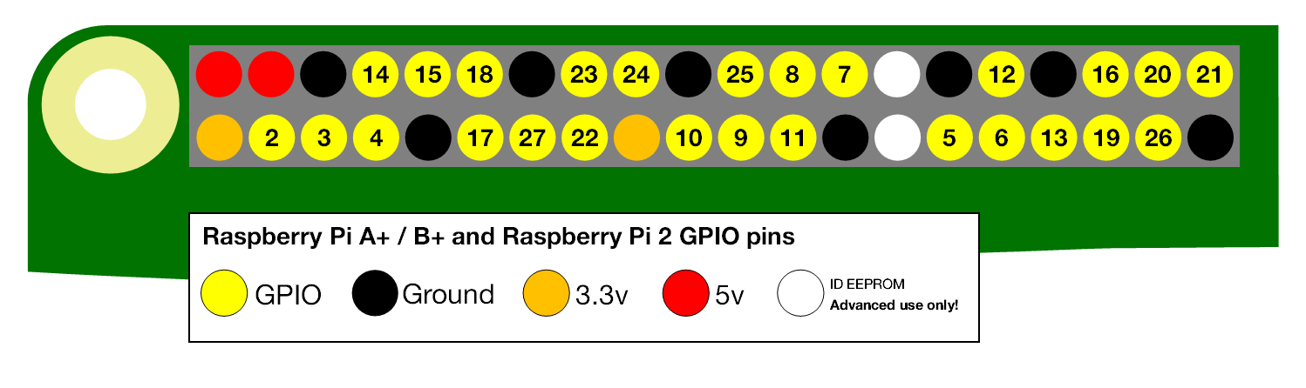
Hardware Interfacing
Interfacing Diagram

Slide 13
Hardware Interfacing – GPS Module
The signals received from the satellites and ground stations contain time stamps of the time when the signals were transmitted.
By calculating the difference between the time when the signal was transmitted and the time when the signal was received. Using the speed of the signal, the distance between the satellites and the GPS receiver can be determined using a simple formula for distance using speed and time.
Using information from 3 or more satellites, the exact position of the GPS can be triangulated.
The GPS receiver module uses UART communication to communicate with controller or PC terminal.

Slide 14
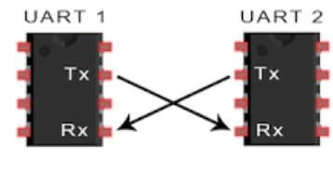
Hardware Interfacing – GPS Module
UART stands for Universal Asynchronous Receiver/Transmitter.
UART is a physical circuit in a microcontroller, or a stand-alone IC.
UART's main purpose is to transmit and receive serial data.

Slide 15
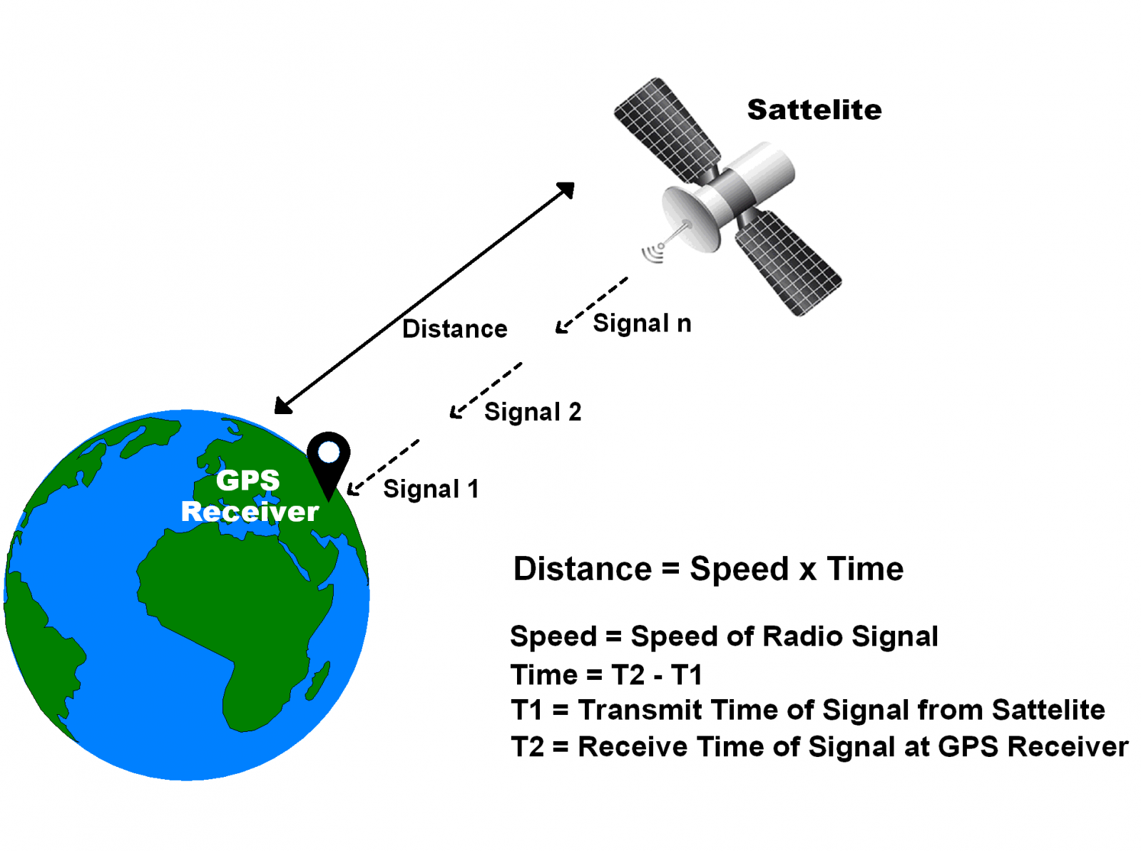
How GPS Module Works

Slide 16
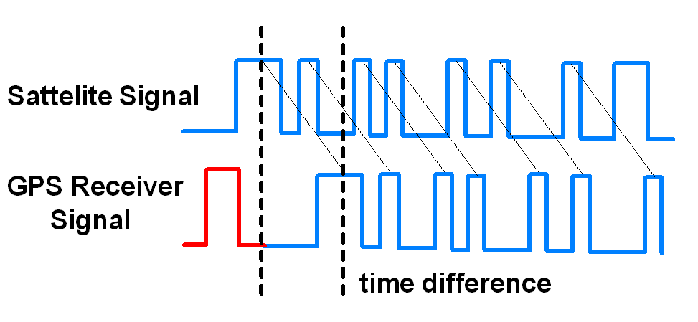
How GPS Module Works

Slide 17
How GPS Module Works
To determine distance, both the satellite and GPS receiver generate the same pseudocode signal at the same time.
The satellite transmits the pseudocode; which is received by the GPS receiver.
These two signals are compared and the difference between the signals is the travel time.
Now, if the receiver knows the distance from 3 or more satellites and their location (which is sent by the satellites), then it can calculate its location by using Trilateration method.

Slide 18
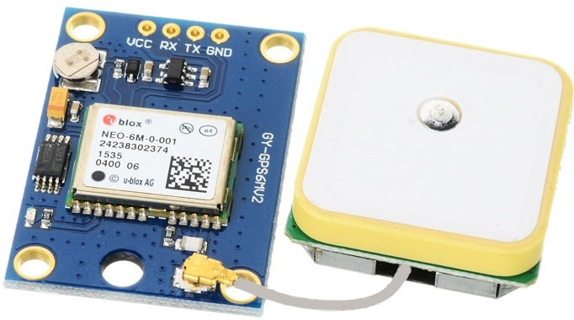
Specifications of NEO-6m-v2 GPS Module:
Has Ceramic Antenna for stronger signals
Has LED indicator for signal status
Has EEPROM, Flash, Button Cell for hot-start up to 15 mins
9600 baud rate - means that the serial port is capable of transferring a maximum of 9600 bits per second
VCC: Power Supply 3.3 – 6 V
GND: Ground
TX: Transmit data serially which gives information about location, time etc.
RX: Receive Data serially. It is required when we want to configure GPS module.

Slide 19
Hardware Codes:
import serial
import time
import string
import pynmea2
import firebase_admin
from firebase_admin import credentials, db
#cred = credentials.Certificate("path/to/serviceAccountKey.json")
cred = credentials.Certificate("key.json")

Slide 20
Hardware Codes:
firebase_admin.initialize_app(cred, {
'databaseURL' : 'https://buslocation-d0065.firebaseio.com'
})
#firebase_admin.initialize_app(cred)
root = db.reference()
while True:
port="/dev/ttyAMA0"
ser=serial.Serial(port, baudrate=9600, timeout=0.5)
dataout = pynmea2.NMEAStreamReader()
newdata=ser.readline()

Slide 21
Hardware Codes:
# inside while True:
if newdata[0:6] == "$GPRMC":
newmsg=pynmea2.parse(newdata)
lat=newmsg.latitude
lng=newmsg.longitude
gps = "Latitude=" + str(lat) + "and Longitude=" + str(lng)
#print(gps)
if(lat!=0 and lng!=0):
root.child('drivers/bus17/l').update({0: lat, 1: lng})
time.sleep(1.3)

Slide 22
Hardware Photos:

Slide 23
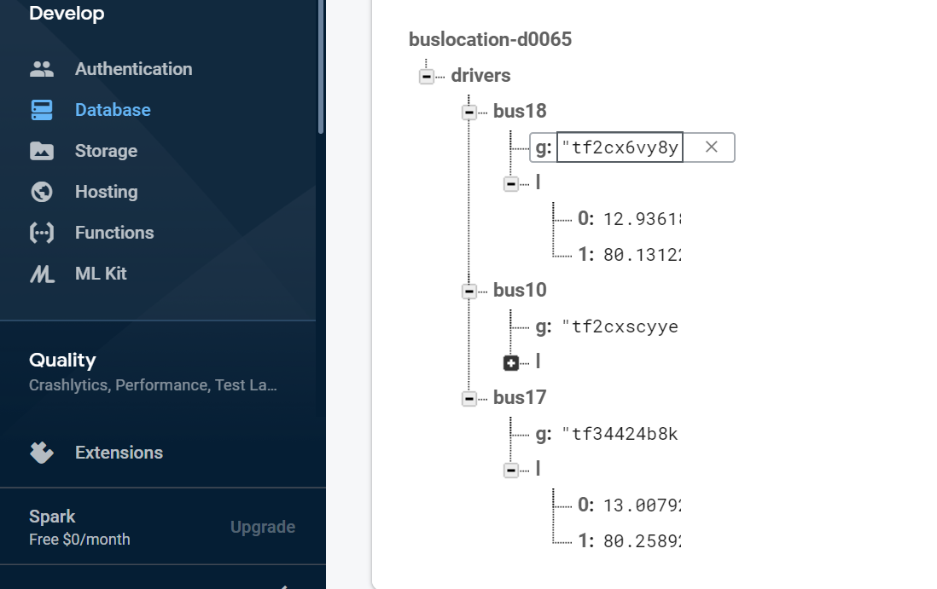
FIREBASE - CLOUD

Slide 24
Software Codes:

Slide 25
VEHICLE TRACKING AND MONITORING SYSTEM TO ENHANCE THE SAFETY AND SECURITY DRIVING USING IoT:
Besides tracking the location of the vehicle, information of engine temperature to prevent the ignition/spark, information about the condition of the driver such as, Drunk/Drossiness is detected.
Steps followed in this paper:
GPS Module is installed
Monitoring the moving vehicle
Checking for temperature of engine, drowsy driver, etc
Obtain results
If any deviation, stop vehicle and play alarm and report
Used: LPC2148 Microcontroller, SIM800, C Programming
This implementation does not have features like ETAs, showing all routes of an organization, alarms for denoting the bus is nearby, etc.
Also LPC2148 is not as scalable as Raspberry pi

Slide 26
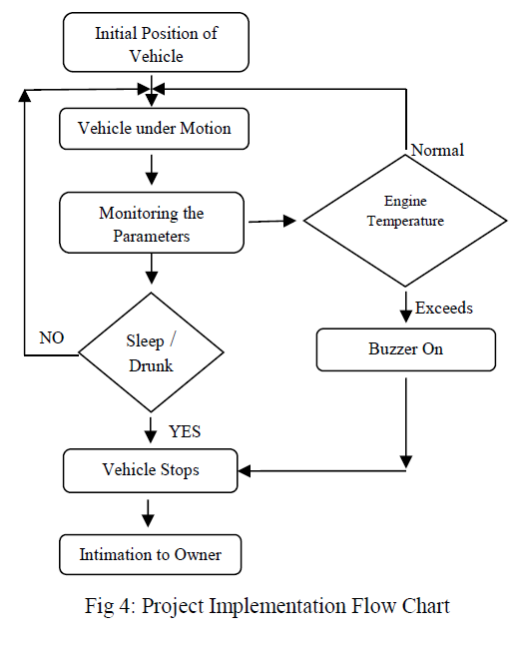
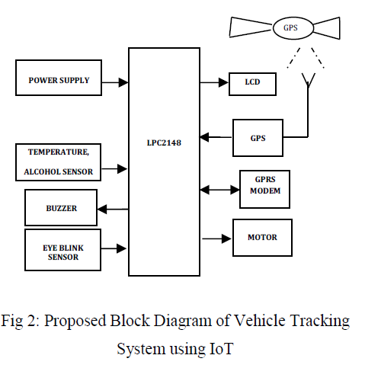
VEHICLE TRACKING AND MONITORING SYSTEM TO ENHANCE THE SAFETY AND SECURITY DRIVING USING IoT:

Slide 27
An Android-based IoT System for Vehicle Monitoring and Diagnostic:
In this paper:
GPS Module is installed
Vehicle data transmitted via CAN-BUS
Usage of IMU Sensor (inertial measurement unit) (for GPS receiver to work when GPS-signals are unavailable, such as tunnels, etc (using accelerometers, gyroscopes, magnetometers, etc.))
Upload to cloud server using mobile network
Used: MCP2515 CAN-BUS (primarily intended for high-speed automotive applications using baud rates from 60 kbaud up to 1 Mbaud), HTML 5, CSS, JS, Java Native Interface
This implementation too does not have features like ETAs, showing all routes of an organization, alarms for denoting the bus is nearby, etc.

Slide 28
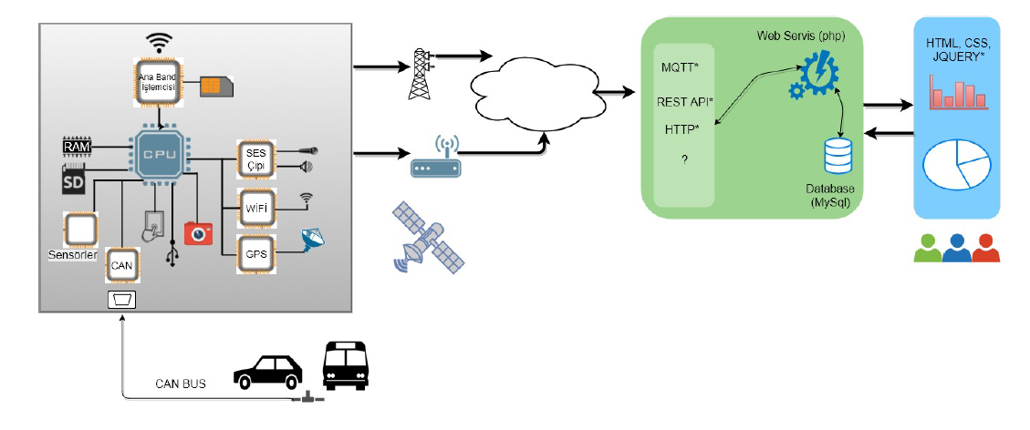
An Android-based IoT System for Vehicle Monitoring and Diagnostic:

Slide 29
Energy-Efficient Location Tracking with Smartphones for IoT
SenSTrack periodically collects data from the sensors correspondingly for detecting turning point/speed and correspondingly distance from the last recorded location. When WiFi is active and GPS isn’t available , using network based location sensing method to get the raw coordinates
1) Orientation:
Orientation sensor is employed as a turning point detector of turning point.This is based on the idea that no need is there for users location recording if he/she is in a steady movement witjour no direction change
2) Acceleration:
Mobile device accelerometer is used in many location sensing system for detection of movement. Distance is integration of speed which inturn is that of acceleration.So using this as the base idea explored is the possibility of distance calculation that the user has moved and also the speed
C. Switching Location Sensing Method
GPS sensors cant work indoors.Smartphones besides GPS use network based localization which uses GSM footprints from cell tower and use WiFi signals to get the approximate location.Although sensing isn’t that accurate as that of GPS. The idea used here is switching from GPS to network based location if GPS signal is invalid and there is an wireless network connection which is active.
D. Track Reconstruction
A Gaussian Process Regression method which is a machine learning technique is used to do interpolation so that the reconstructed track can be more smooth and users actual path Is fitted.

Slide 30
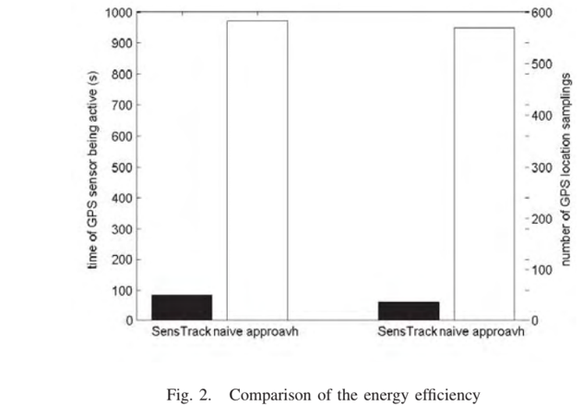
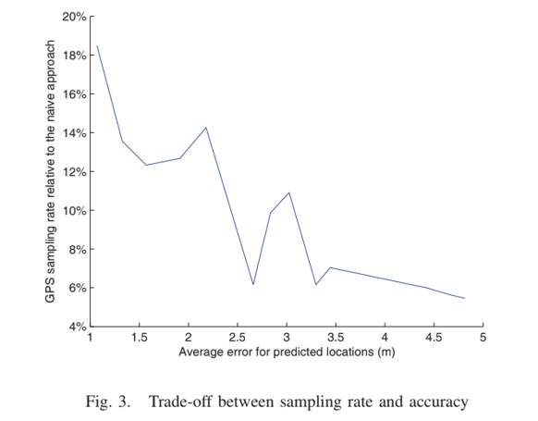
Energy-Efficient Location Tracking with Smartphones for IoT

Slide 31
IOT Based Vehicle Monitoring System
The objective is to track vehicle’s parameters and location from a centralized place.
A combination of GPS GPRS and IoT is used
Proposed system mainly consists of a microcontroller and GPS + GPRS module. Vehicle parameters and location coordinates from GPS module are fed to the controller.
Controller transfers this data to server with the help of GSM/GPRS technology. Sim808 module is used for GPS and GSM/GPRS connectivity along with Arduino controller.
Parameters stored in database and showed via webpage
Hardware Requirements
Arduino
Open source platform
Based on control chips used different variants are there
Eg- ATMEGA Arduino Mega 2560

Slide 32
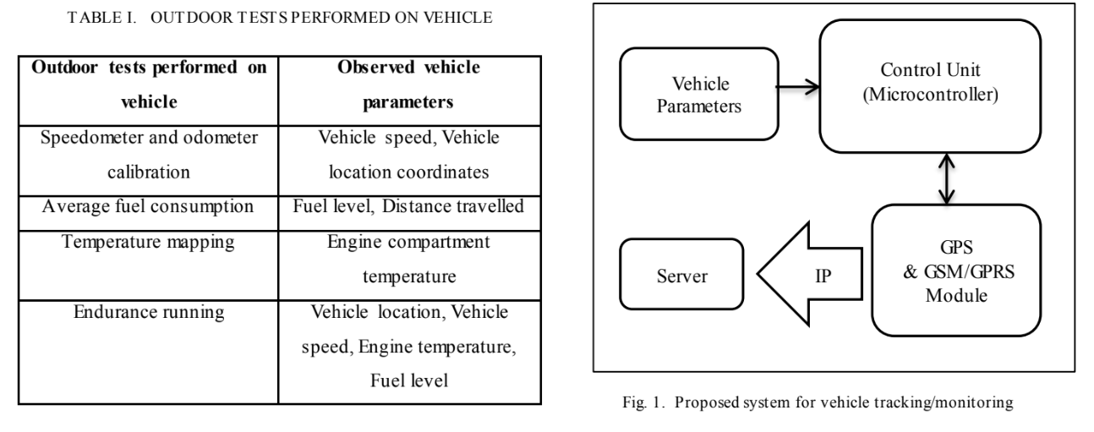
IOT Based Vehicle Monitoring System

Slide 33
Near Real-time tracking of IoT devices
Usecase: For disaster rescue operations, to know the exact location of users within closed confined spaces.
Design Goals: Less Energy Intensive, minimal communication traffic, most info is snapshot based.
To reduce the overhead involved in real-time tracking of (mobile) IoT devices, the scheme proposed adopts a quasi- real-time tracking approach utilizing the LIDx protocol and its period, and collects only a small amount of information in each snapshot; such as time, remaining energy in the mobile device, and the type of communications interface.

Slide 34
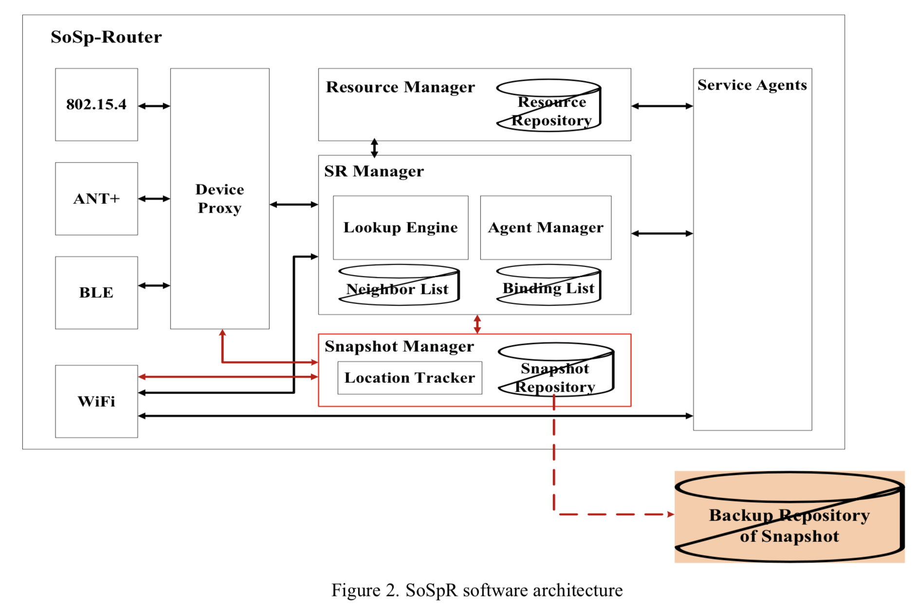
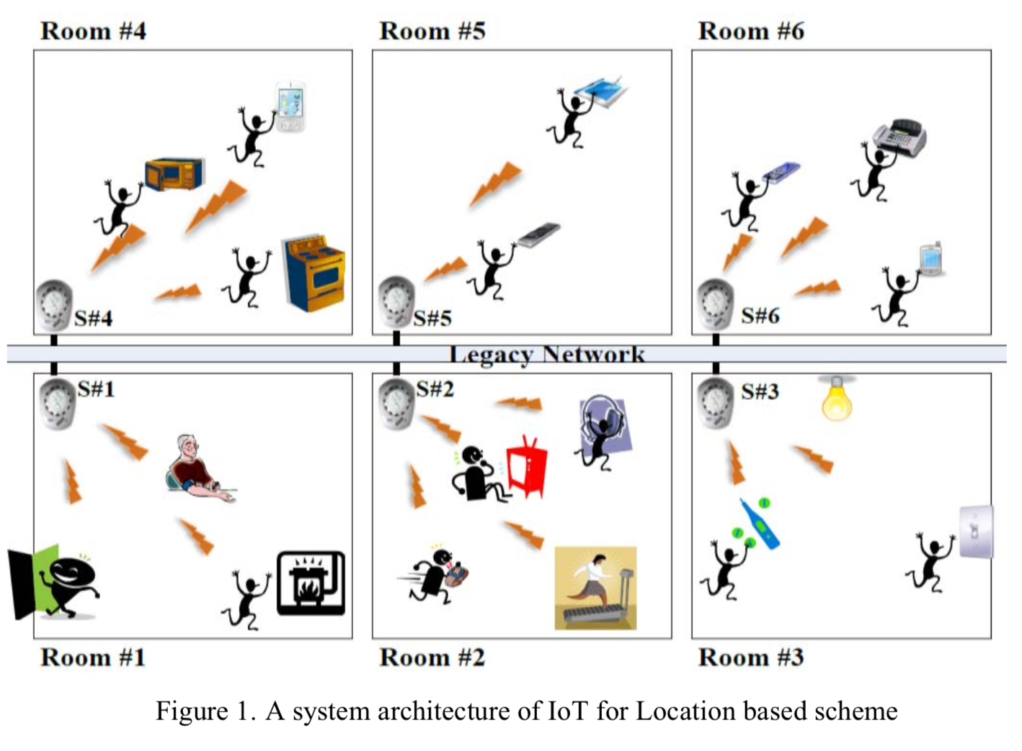
The system architecture of the proposed system, SoSpR internal structure, message info
Uses Self-Organising Software Platform Router (SoSpR) as the gateway for communication and collection of snapshot info from the IoT devices.
SoSpR has flash memory, RAM, processor and has variety of communication interfaces like Bluetooth, ZigBee, NFC, WiFi to connect with mobile IoT devices in unit space. It sends a LiDx request signal for snapshot and the collect snapshot is ordered by time and backed up to a repository.
Info collected: Device ID, remaining energy, register time, Remote/Close, running applications, etc.

Slide 35
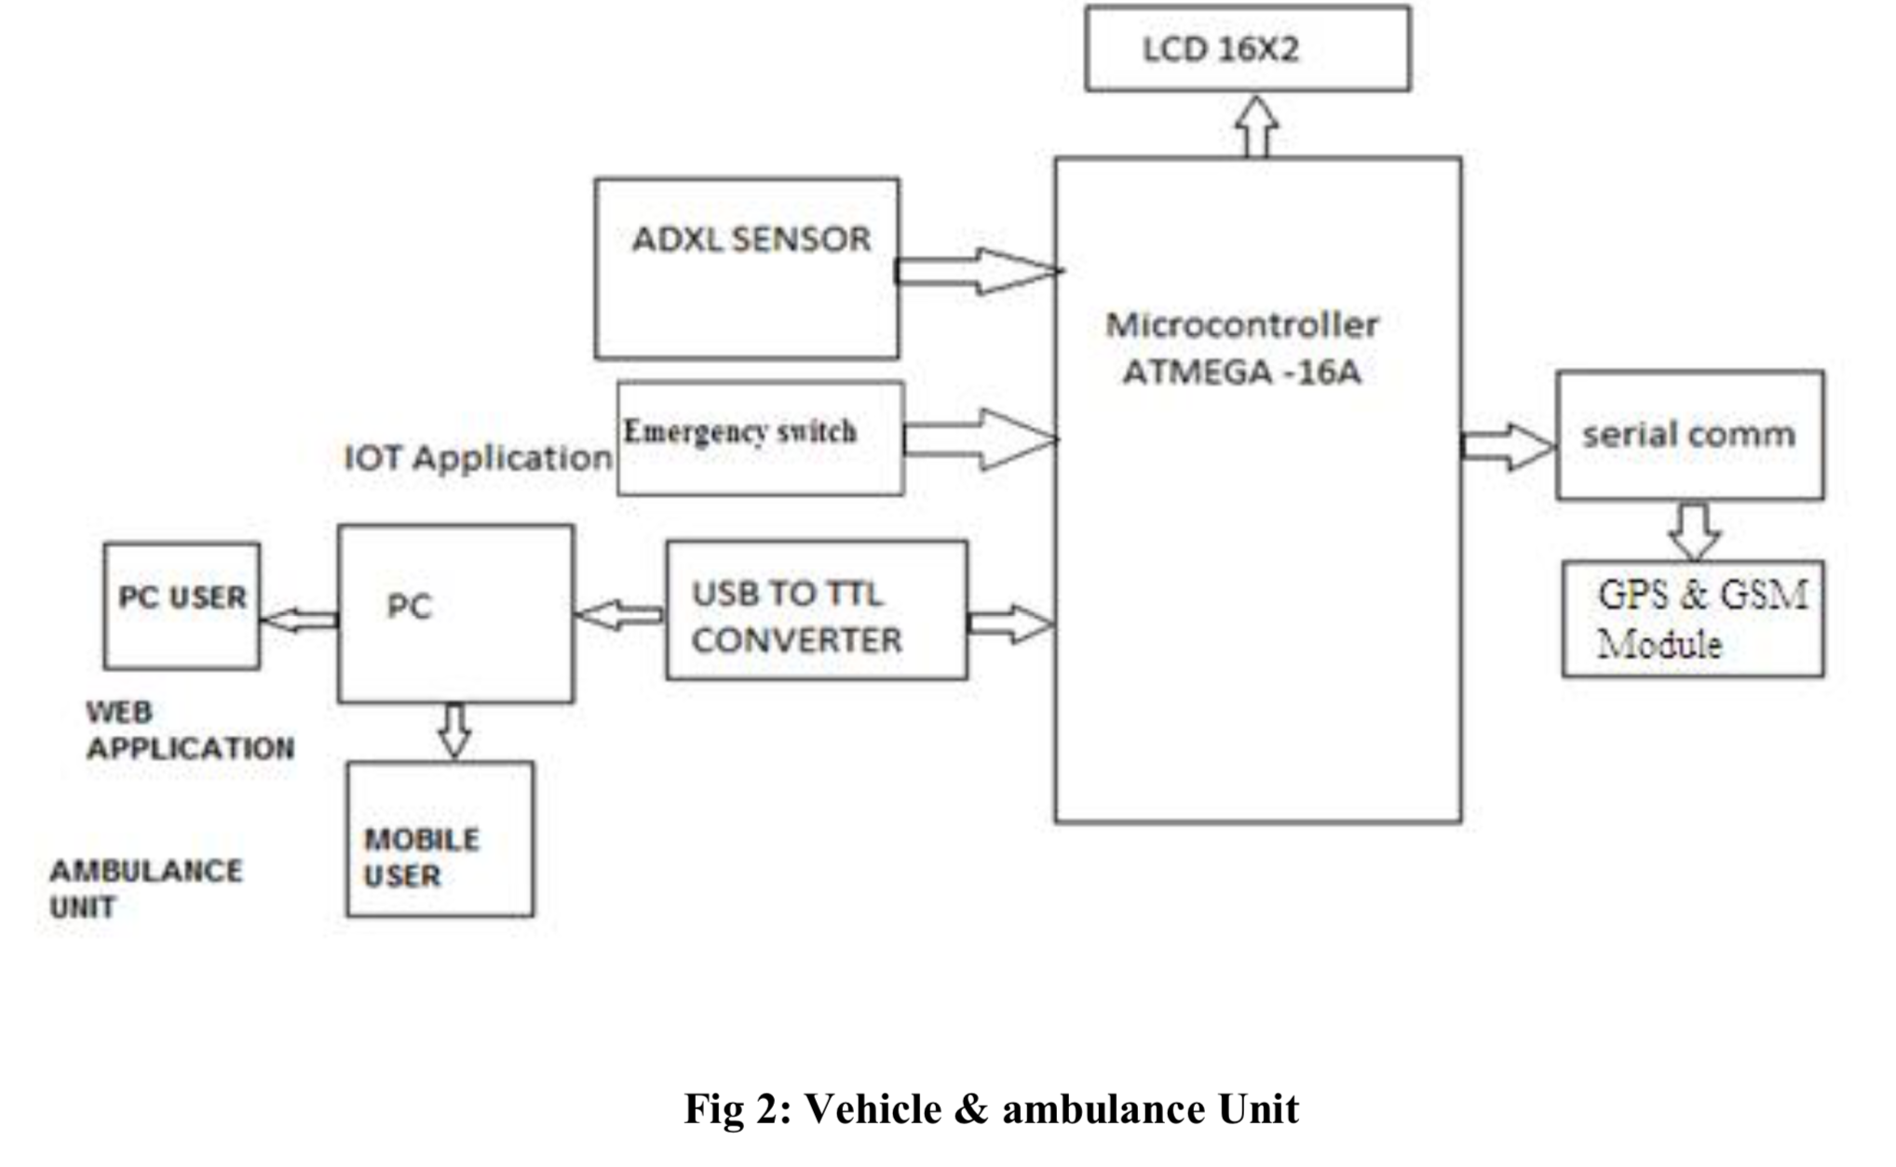
IOT based Vehicle Tracking & Vehicular Emergency System- A Case Study and Review
Patole Gitanjali et. al
3 units: The Vehicle Unit & The Ambulance Unit, The Traffic unit, Main Server
Vechile unit has a controller (ATMEGA 16A), ADXL sensor, GPS system. The vibration sensor senses for any large scale vibration in the vehicle and the sensed data is sent to the micro controller, which takes the GPS information and sends to the IoT web server.
The ADXL335 is a small, thin, low power, complete 3-axis accelerometer with signal conditioned voltage outputs. The product measures acceleration with a minimum full-scale range of ±3 g. It can measure the static acceleration of gravity in tilt-sensing applications, as well as dynamic acceleration resulting from motion, shock, or vibration.
Global System Mobile (GSM) comprises of mobile station, base station, network subsystem and the GPS.

Slide 36
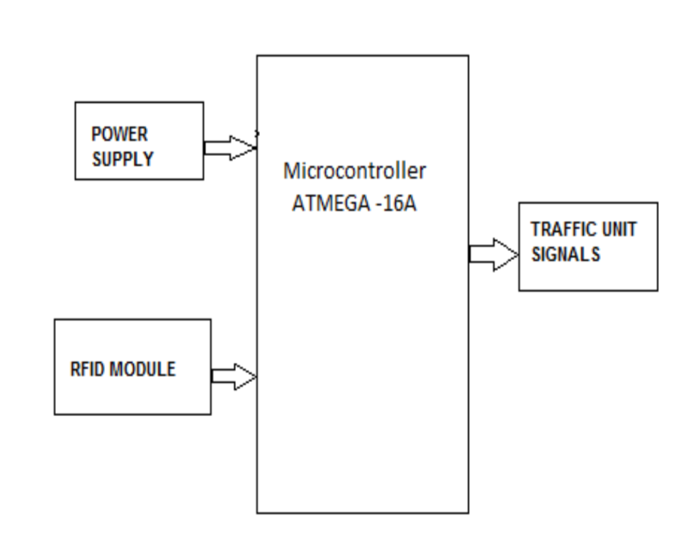
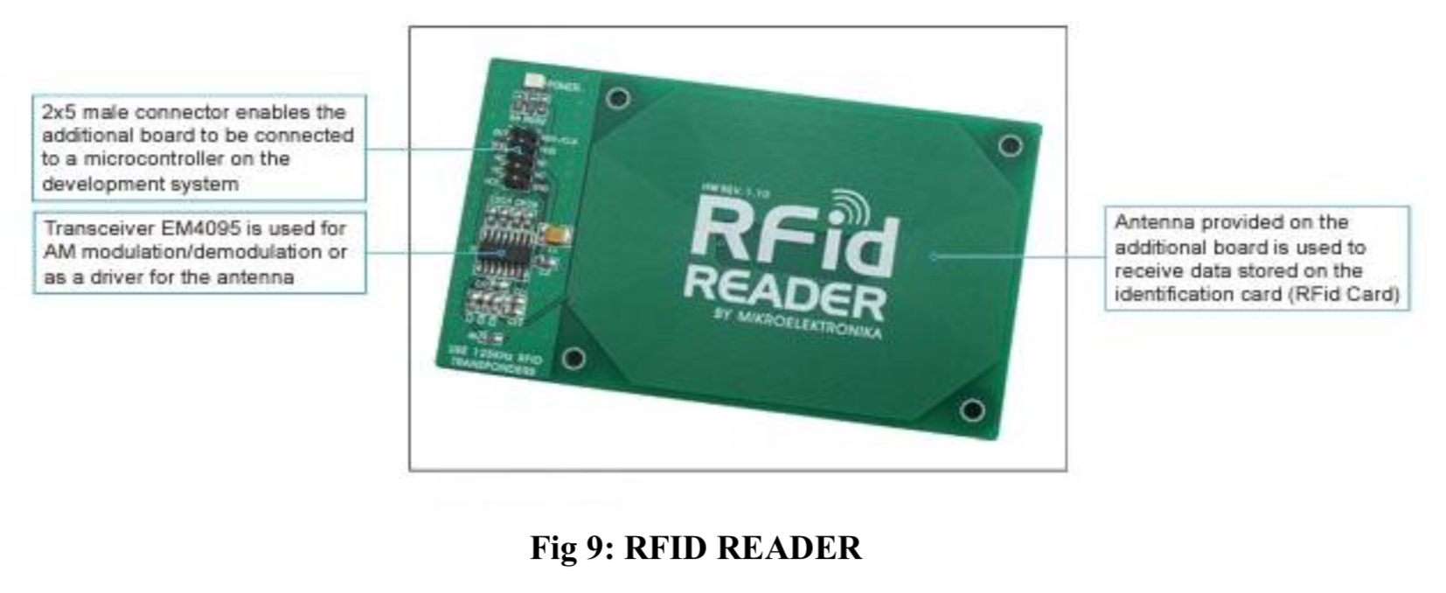
Traffic Unit

Slide 37
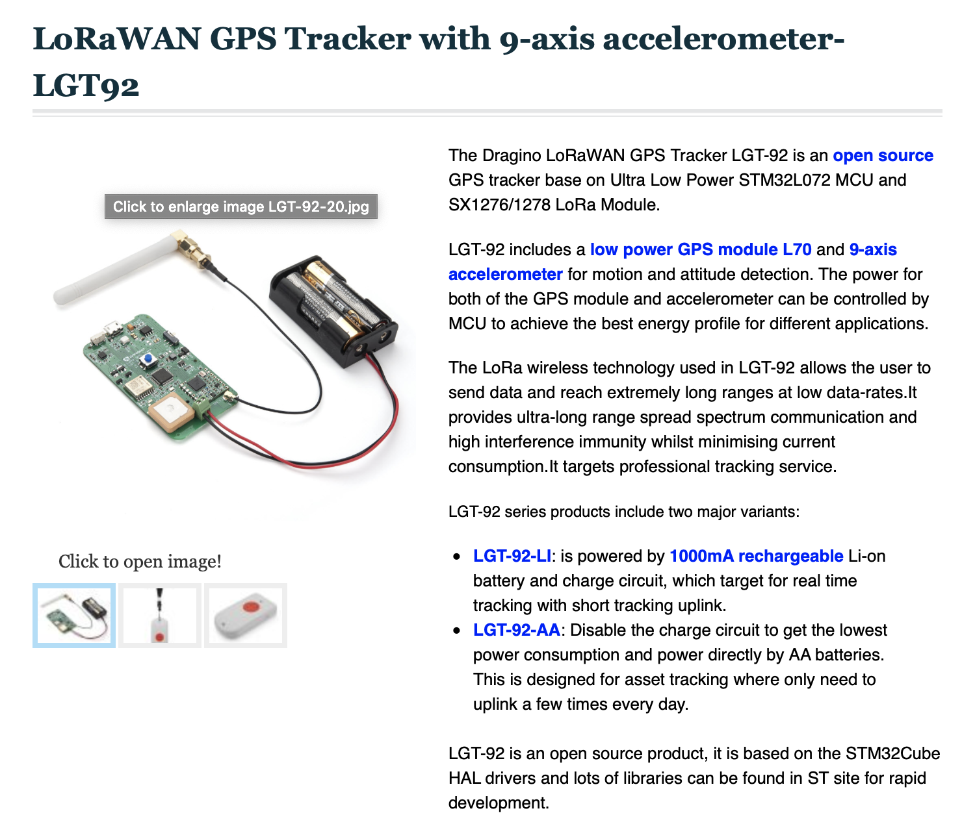
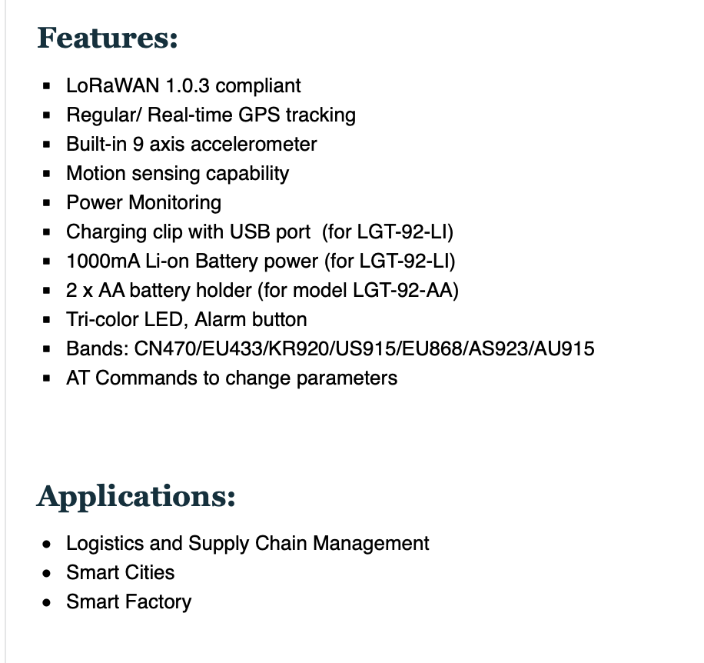
LoRaWAN end-node GPS tracker

Slide 38
THANK YOU!

